Slide 1


Chapter Eleven
The Economics of Immigration
Prepared by Dr. Mir Ahasan Kabir
York University

Slide 2
Learning Objectives
Provide a descriptive profile of immigrants to Canada, including the following information: how many immigrants arrive each year, where do they come from, and where do they settle?
Describe Canada’s immigrant point system, and the role it plays in determining the admission of immigrants to Canada.
Use the supply and demand framework to evaluate the theoretical impact of immigration on the labour market, and use this model to discuss the empirical evidence of the impact of immigration.
Define the concept of “immigrant earnings assimilation,” and explain the pitfalls of using a single cross-section data set to estimate the rate of assimilation.
Sketch a simple economic model of migration, including an answer to the question, when should someone move countries?
© 2021 MCGRAW-HILL EDUCATION LTD.
11 - <number>

Slide 3
Main Questions
How have patterns of immigration to Canada changed over the past 60 years? From which countries do immigrants come, and where do they settle upon arrival in Canada?
What is the “point system,” and what impact does it have on immigration to Canada?
Overall, does immigration have a positive or negative impact on the labour market outcomes of the native born? In particular, are higher levels of immigration associated with downward pressure on wages or increases in unemployment?
In what respects do immigrants assimilate? How long does it take for an immigrant’s earnings to catch up to those of a native-born Canadian?
Are immigrants a net drain on the public treasury, especially through higher dependence on social assistance?
© 2021 MCGRAW-HILL EDUCATION LTD.
11 - <number>

Slide 4
Profile of Immigration to Canada
Until the mid-1980s overall immigration levels fluctuated considerably
200,000 immigrants per year to around late 1990s
From 2000 onward, immigration levels have increased, to over 270,000 in 2015
Per-capita immigration levels are slightly lower
Source regions have changed dramatically
© 2021 MCGRAW-HILL EDUCATION LTD.
11 - <number>

Slide 5
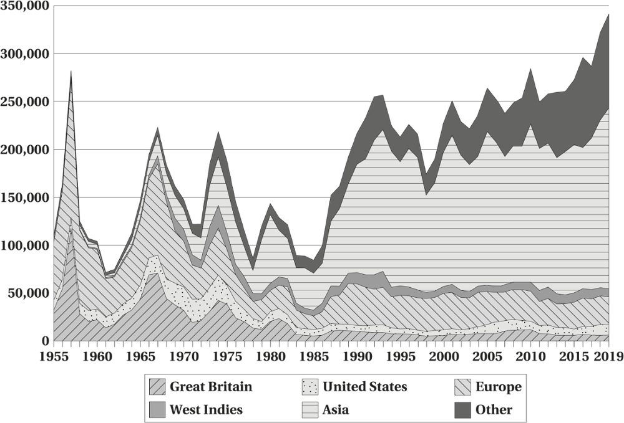
Profile of Immigration to Canada
Figure 11.1 Immigration to Canada by Source Region, 1955–2019
© 2021 MCGRAW-HILL EDUCATION LTD.
11 - <number>

Slide 6
Profile of Immigration to Canada
Table 11.1 Top Ten Immigrant Source Countries, 2005 and 2019
Rank | 2005 |  | 2019
1 | China (PRC) | 42,568 | India | 85,590
2 | India | 36,179 | China (PRC) | 30,245
3 | Philippines | 18,137 | Philippines | 27,820
4 | Pakistan | 14,314 | Nigeria | 12,600
5 | United States | 8,392 | Pakistan | 10,795
6 | United Kingdom | 7,253 | United States | 10,780
7 | Colombia | 6,424 | Syria | 10,120
8 | Iran | 5,837 | Eritrea | 7,030
9 | Korea, Republic of | 5,826 | Korea, Republic of | 6,105
10 | Romania | 5,048 | Iran | 6,055
Top 10 source countries |  | 149,978 |  | 207,140
Percentage accounted for by top 10 |  | 57 |  | 61
Percentage accounted for by top four |  | 42 |  | 46
Others |  | 112,268 |  | 134,040
Total |  | 262,246 |  | 341,180
© 2021 MCGRAW-HILL EDUCATION LTD.
11 - <number>

Slide 7
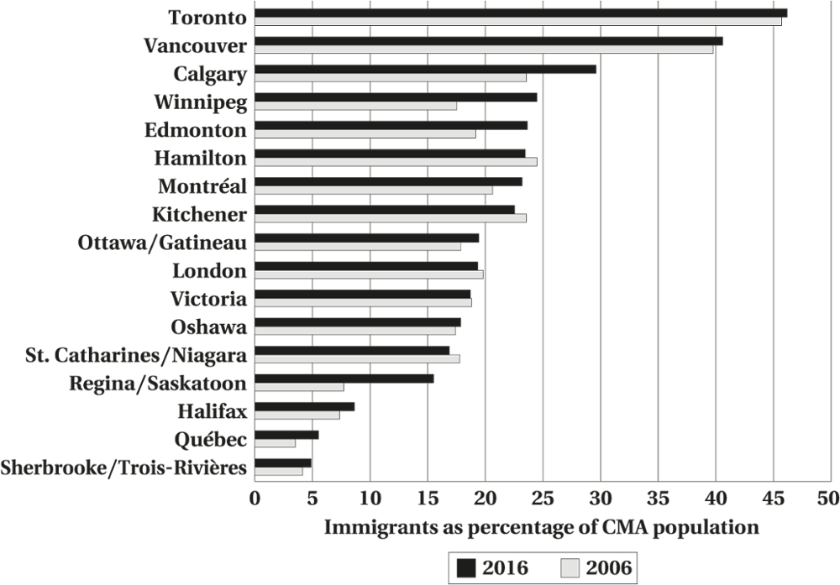
Profile of Immigration to Canada
Figure 11.2 Immigrant Concentration by Census Metropolitan Area, 2006 and 2016
© 2021 MCGRAW-HILL EDUCATION LTD.
11 - <number>

Slide 8
The Policy Environment
Two “levers”
  Number of immigrants
  Who is admitted
What the policymakers are trying to achieve?
© 2021 MCGRAW-HILL EDUCATION LTD.
11 - <number>

Slide 9
The Policy Environment
Immigration Policy
Assume policy makers are attempting to maximize “national welfare”
  Admitting immigrants to alleviate specific skill shortages or contributing to economic growth
  Family reunification
  Sanctuary from political persecution
© 2021 MCGRAW-HILL EDUCATION LTD.
11 - <number>

Slide 10
The Policy Environment
Two Classes
Assessed
  Evaluated on the basis of their likely contribution and success in Canadian labour market
  Independent immigrants
  Point system
Non-assessed
  Family and refugee classes
© 2021 MCGRAW-HILL EDUCATION LTD.
11 - <number>

Slide 11
The Policy Environment
Canada’s Immigration Point System, 2016
Work experience: Individuals must have at least one year of recent full-time work experience in a broadly defined skilled occupation.
Language: Individuals must meet a minimum score on a sanctioned language test,
Minimum funds: Individuals must demonstrate sufficient “start-up” funds to support themselves on arrival in Canada.
Minimum score: Individuals need to obtain a minimum score (67 out of 100) according to six selection criteria: education (25), official language (28), work experience (15), age (10), arranged employment in Canada (10) and adaptability (10).
© 2021 MCGRAW-HILL EDUCATION LTD.
11 - <number>

Slide 12
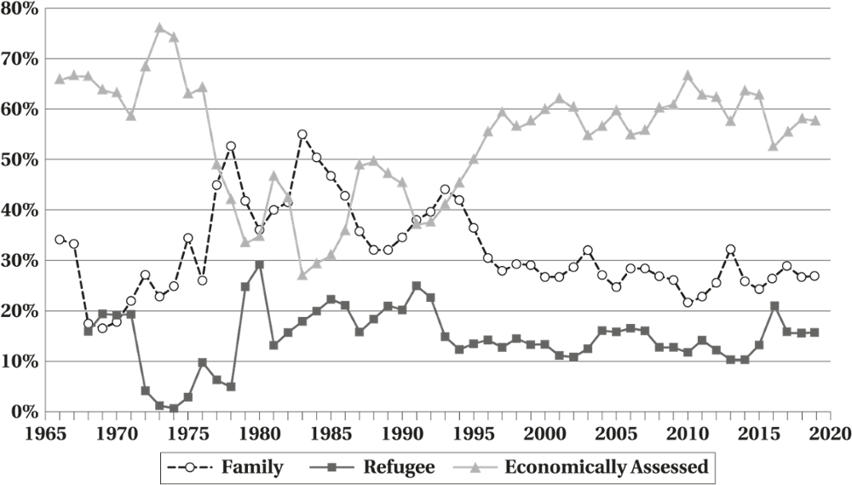
The Policy Environment
Figure 11.3 Immigration to Canada by Class of Immigrant, 1966 to 2019
© 2021 MCGRAW-HILL EDUCATION LTD.
11 - <number>

Slide 13
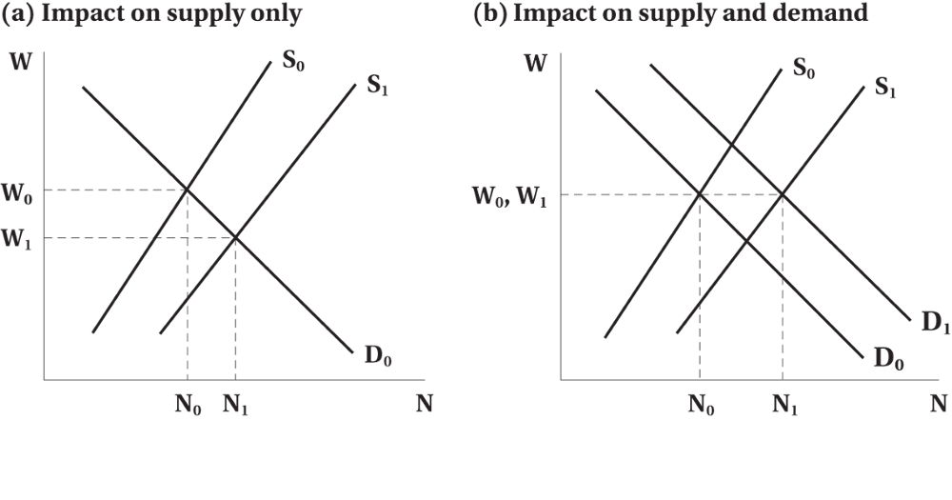
The Impact of Immigrants on the Labour Market
Figure 11.4 The Impact of Immigration on Employment and Wages
© 2021 MCGRAW-HILL EDUCATION LTD.
11 - <number>

Slide 14
The Impact of Immigrants on the Labour Market
Estimating the Effects of Immigration
The difficulties of estimating the effect of immigration
  Absence of “Counterfactual” Cases
Exploit cross-city variation in immigration
Exploit “natural experiments”
Combining the “cross city” approach and the “natural experiments” approach.
© 2021 MCGRAW-HILL EDUCATION LTD.
11 - <number>

Slide 15
The Impact of Immigrants on the Labour Market
Findings of Empirical Research
Hard to find evidences on whether immigration has an adverse impact on the labour market
There is a strong skill dimension to the impact of immigration.
© 2021 MCGRAW-HILL EDUCATION LTD.
11 - <number>

Slide 16
Economic Assimilation
Assimilate in terms of hours working
Starting out at a lower level than a native-born individual
Expect wages to increase over time
© 2021 MCGRAW-HILL EDUCATION LTD.
11 - <number>

Slide 17
Economic Assimilation
Initially the immigrant may suffer an earning penalty (entry effect)
As the immigrant ages, his/her earnings should also rise
If assimilation is quick, disparity offset by a short catch-up period
© 2021 MCGRAW-HILL EDUCATION LTD.
11 - <number>

Slide 18
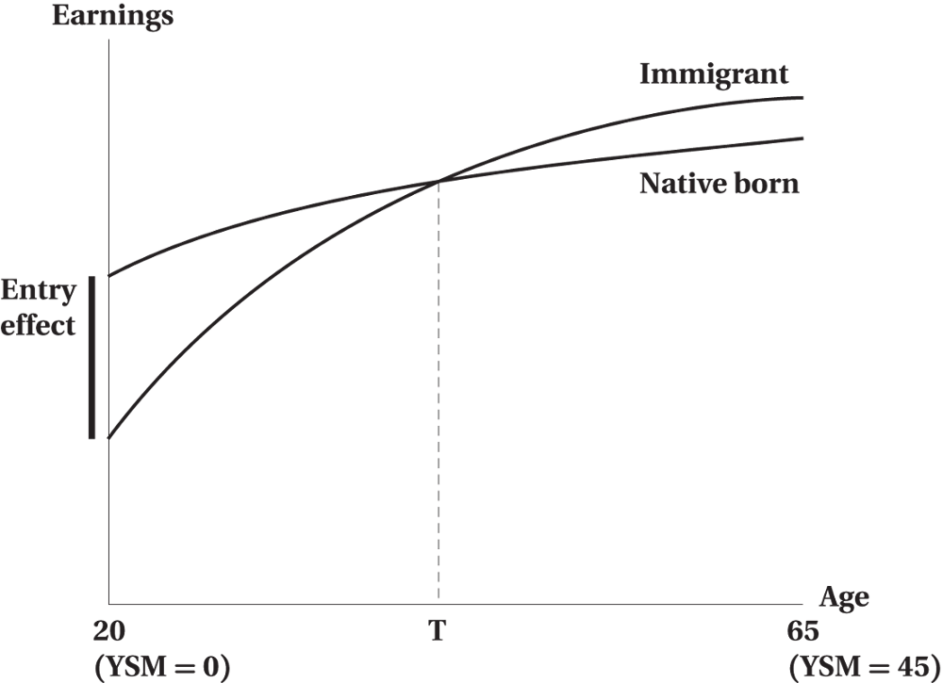
Economic Assimilation
Figure 11.5 Hypothetical Assimilation Profile, 20-Year-Old Immigrant
© 2021 MCGRAW-HILL EDUCATION LTD.
11 - <number>

Slide 19
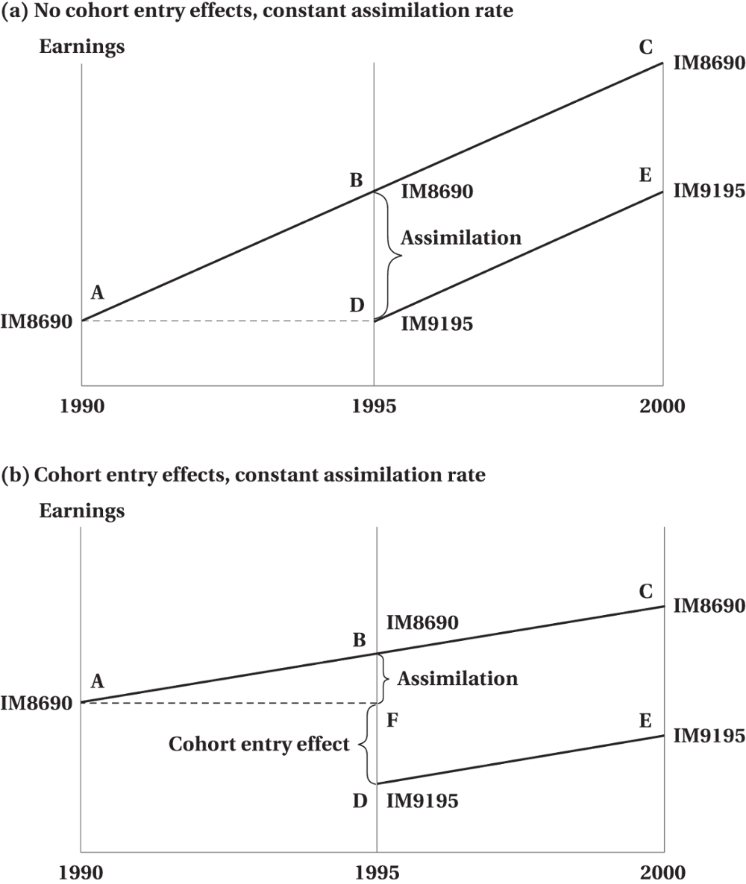
Economic Assimilation
Figure 11.6 Measuring Earnings Assimilation: Disentangling Cohort and Assimilation Effects
© 2021 MCGRAW-HILL EDUCATION LTD.
11 - <number>

Slide 20
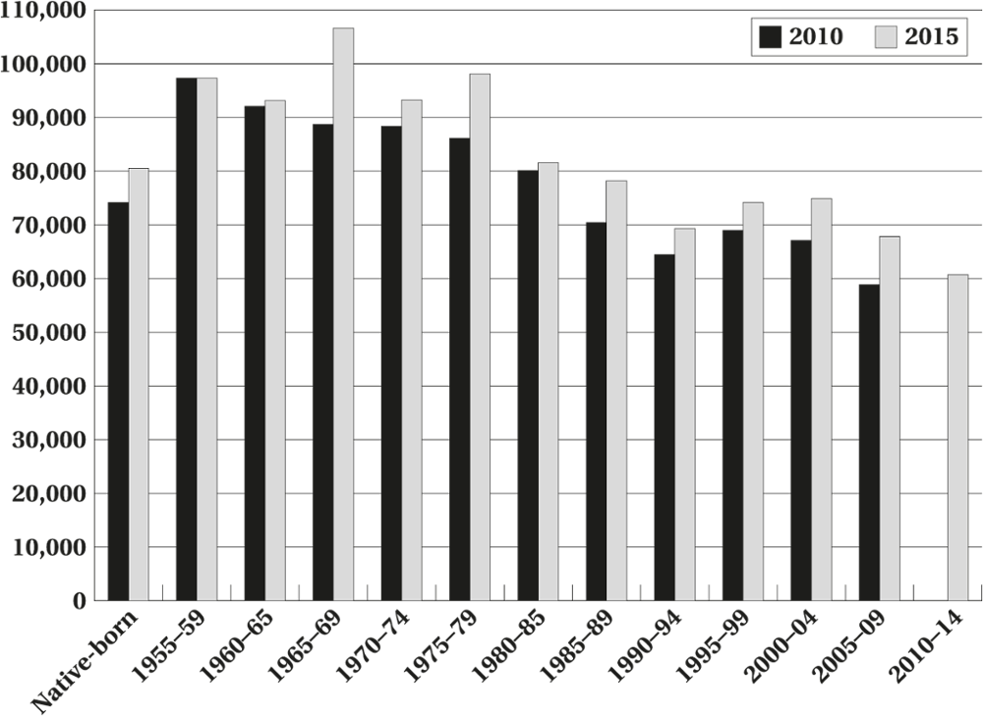
Economic Assimilation
Figure 11.7 Annual Earnings by Immigrant Cohort, 2010 and 2015
© 2021 MCGRAW-HILL EDUCATION LTD.
11 - <number>

Slide 21
Economic Assimilation
Worked Example:
Comparing Cross-Section and Quasi-Panel Estimates of Assimilation
Cohort | Observed in 1995 | Observed in 2000 | Change between 1995 and 2000
Native born | $46,999 | $48,641 | $1,642
IM8185 | 42,294 | 45,962 | 3,669
IM8690 | 36,580 | 41,588 | 5,008
IM9195 | 31,423 | 38,652 | 7,229
© 2021 MCGRAW-HILL EDUCATION LTD.
11 - <number>

Slide 22
Economic Assimilation
Entry effect: This is the difference in income between new immigrants and the native born.
The entry effect for IM9195: $46,999 - $31,423 = $15,576
Cross-Section Microdata: $36,580 - $31,423 = $5157
Quasi-Panel: tracks the actual cohorts over time.
IM9195 earnings grow faster than the native born:
$7229 - $1642 = $5587.
© 2021 MCGRAW-HILL EDUCATION LTD.
11 - <number>

Slide 23
Economic Assimilation
Empirical Evidence
The entry effect is generally worsening over time.
  Immigrants are starting out further behind the native born.
The return to a year of education (and experience) is much lower for immigrants educated outside Canada.
The assimilation rates are uniformly too low for the average earnings of any cohort of immigrants to catch up to the native born
Women tend to suffer a slightly smaller earnings entry effect, but the general patterns are very similar
© 2021 MCGRAW-HILL EDUCATION LTD.
11 - <number>

Slide 24
Immigrant Outcomes and Public Policy
Canadian Point System vs. U.S. Family Reunification
  Point system reduces admissions from less developed countries
  Has an impact on tilting immigrant selection towards more skilled groups
  Independent immigrants fare better than family class and refugee immigrants
© 2021 MCGRAW-HILL EDUCATION LTD.
11 - <number>

Slide 25
Impact of Immigration on Source Countries
Brain Drain
Less-developed countries may lose their most skilled labour to more-developed countries
Home countries bear the cost of education and skilled emigrant reaps the benefits
Possible remedies
© 2021 MCGRAW-HILL EDUCATION LTD.
11 - <number>

Slide 26
Impact of Immigration on Source Countries
WORKED EXAMPLE
To Move or Not to Move?
The person is 25 years old.
He can earn $100,000 per year for 40 years in Canada.
He can earn $110,000 per year in the United States for the same 40 years.
Interest rate is 5%.
© 2021 MCGRAW-HILL EDUCATION LTD.
11 - <number>

Slide 27
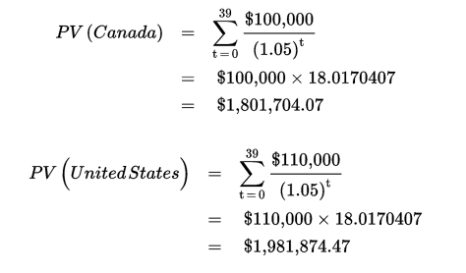
Impact of Immigration on Source Countries
The difference in the present value of income streams is $180,170.41.
© 2021 MCGRAW-HILL EDUCATION LTD.
11 - <number>

Slide 28
Chapter Summary
Profile of Immigration to Canada
Two policy instruments of the Canadian government to control immigration
  Target number
  Mix of assessed and non-assessed classes
The potential impact of new immigrants on the labour market
Assimilation profiles of immigrants
Emigration and “brain drain”
© 2021 MCGRAW-HILL EDUCATION LTD.
11 - <number>

